Slide 1
Food and plans
15. The three futures

Slide 2
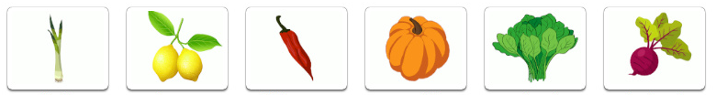

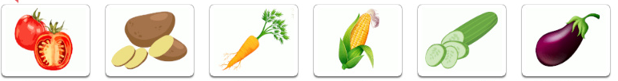
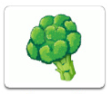
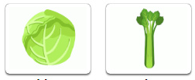

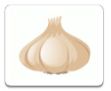
Name the vegetable
1 | 2 | 3 | 4 | 5 | 6
7 | 8 | 9 | 10 | 11 | 12
13 | 14 | 15 | 16 | 17 | 18
19 | 20 | 21 | 22 | 23 | 24
Notes:
Leek
Lemon
Chili pepper
Pumpkin
Spinach
Beetroot
Lettuce
Mushroom
Olives
Onion
Peas
Pepper
Tomato
Potato
Carrot
Corn
cucumber
Eggplant
Broccoli
Cabbage
Celery
Zucchini
Cauliflower
garlic

Slide 3
Will
Certainty level: 50 %
(+) will + bare infinitive = I will start a diet.
(-) will not + bare infinitive = I won’t eat it.
(?) Will + subject + bare infinitive = Will you come to the party?
information about the future
a spontaneous decision
a suggestion / offer / request
a prediction or warning
willingness or refusal to do something
opinion or speculation about the future without information (often after verbs like: think, know, expect, suppose, be sure).
Notes:
We’ll visit you tomorrow.
I’ll do the shopping.
Will you play the piano for us, please?
You’ll catch a cold if you don’t wear a hat.
I’ll make the salad, but I won’t clean the chicken.
I know she will like this book.
I’m sure he’ll arrive soon.

Slide 4
Complete with an appropriate verb
I will _____ dinner tonight.
She won’t _____ veggie pizza for the party.
We will _____ dessert after the main course.
He will _____ a special dish for the occasion.
The restaurant will _____ a discount on Mother’s Day.
I won’t _____ reservations at the steakhouse. I am vegan.
John will _____ fresh ingredients for the recipe.
They will _____ different types of cheese and wine.
Miles and Rainey will _____ a cake for Keith.
The bakery will _____ a new line of pastries.

Slide 5
Going to
Certainty level: 75 %
(+) be going to + bare infinitive = I am going to eat veggies tonight.
(-) be + not + going to + bare infinitive = I am not going to eat healthy tonight.
(?) be + subject + going to + bare infinitive = What are you going to eat tonight?
a plan or intention
a prediction based on present evidence
Notes:
I am going to visit them in May.
The wind is strong. There’s going to be a storm soon.

Slide 6
What is going to happen?
A new seafood restaurant opened last week.
My birthday is coming up.
We planned to have takeout tonight.
There is a cooking class at my favorite restaurant.
Your family is visiting India next year.
James must learn how to cook.
Marissa can’t eat gluten.
Becky wants to go to brunch next weekend.
We need to lose some weight for our summer body.
Steve invited us to his housewarming party.

Slide 7
Present continuous
Certainty level: 99 %
(+) Verb to be + verb ing = I am eating chicken tonight.
(-) Verb to be + not + verb ing = We are not going to the gym tonight.
(?) Verb to be + subject + verb ing = Are we getting salad for dinner?
personal arrangements and fixed plans
Notes:
I am getting my bicycle back this afternoon.

Slide 8
Put the sentences in order
for the family / dinner / I am / tonight. / cooking
She is / ordering / for the office lunch. / sushi
having / this weekend. / a potluck party / We are
creating / The chef is / a new menu / next month.
baking / next week. / a cake / She is / for her sister’s birthday
tomorrow. / I am / the reservation / making
We are / the ingredient / tonight. / buying
attending / Monday. / My roommate is / a cooking class / next
an event / The restaurant is / on Sunday. / hosting
night. / Gina is / pasta / tomorrow / making / homemade
Notes:
I am cooking dinner for the family tonight.
She is ordering sushi for the office lunch.
We are having a potluck party this weekend.
The chef is creating a new menu next month.
She is baking a cake for her sister’s birthday next week.
I am making the reservation tomorrow.
We are buying the ingredient tonight.
My roommate is attending a cooking class next Monday.
The restaurant is hosting an event on Sunday.
Gina is making homemade pasta tomorrow night.

Slide 9
Choose the correct one
Is / Are / Will you going out to dinner on Saturday night?
When is Mr. Smith’s train arriving / arrive / will arrive next Thursday?
Is Alex returning home later today? No, he doesn’t / isn’t / won’t.
When are they going / they are going / is they going on their vacation next month?
Why isn’t Frank is going to work / will work / working tomorrow?
Who is come / is coming / are coming to the party next Friday?
Are Bob and Susan getting married in October? No, they isn’t / aren’t / are.
Is / Will / Are your daughter running in the competition on Sunday?
Notes:
Are
Arriving
Are they going
Working
Is coming
Arent
is

Slide 10
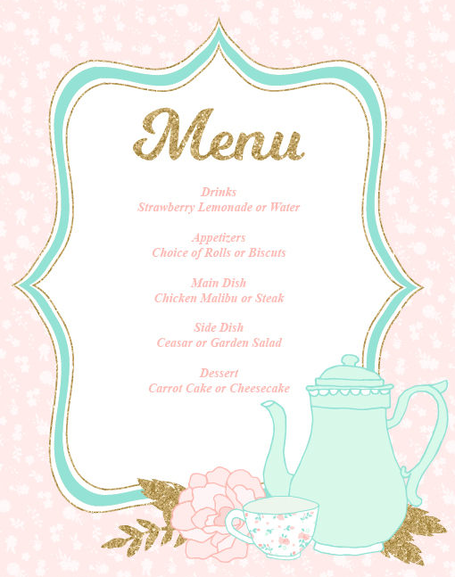
Organize an imaginary dinner
You are having a party tomorrow night.
Choose a menu with an appetizer, main dish, and dessert.
Decide who will bring each dish.

